Slide 1
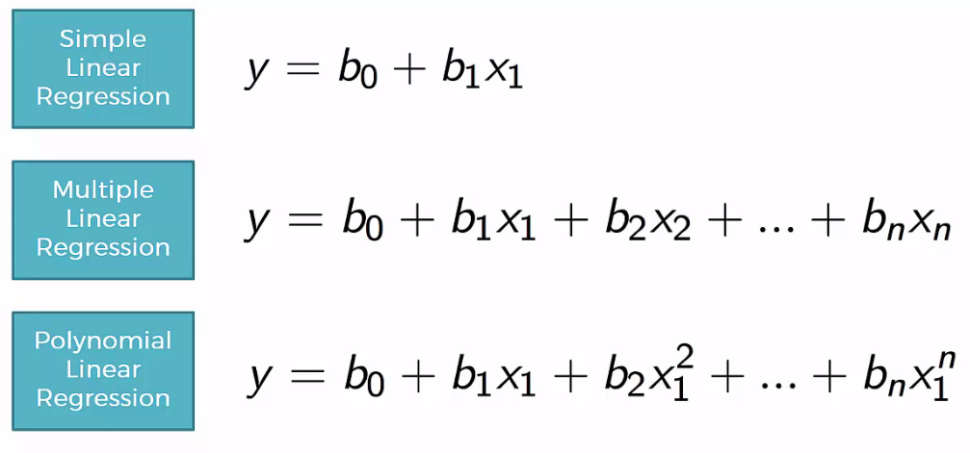
Regressions:

Slide 2
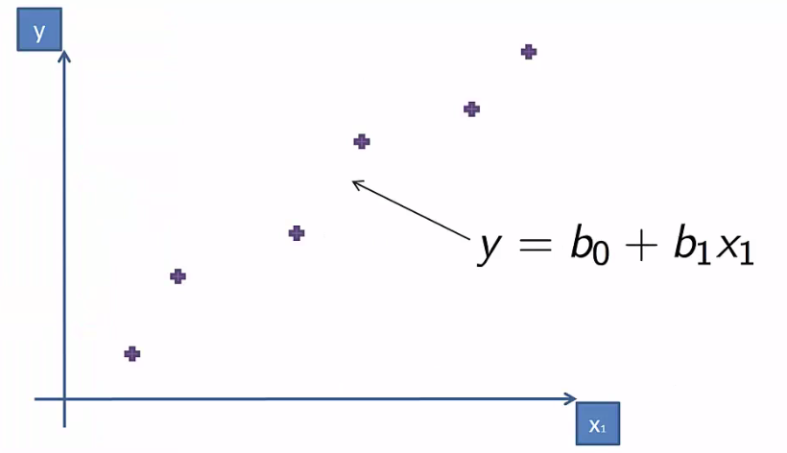
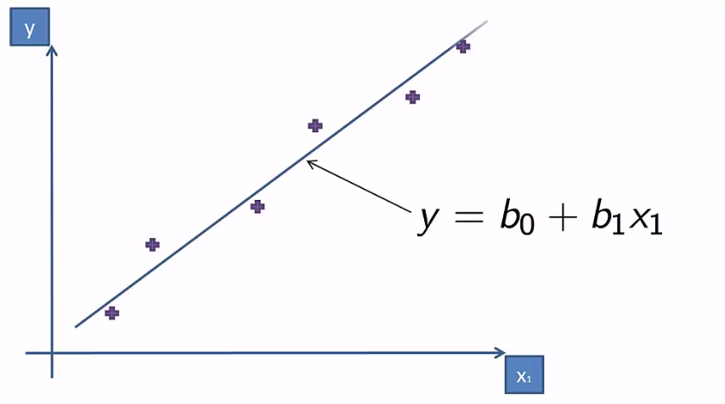
Simple Linear Regression

Slide 3
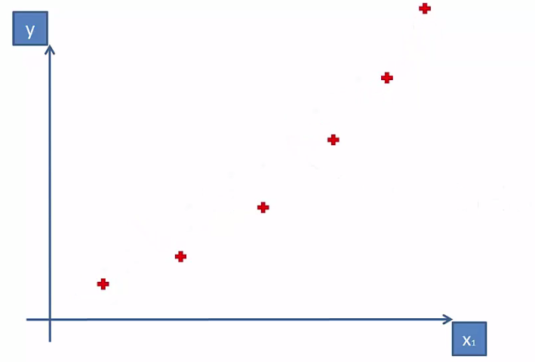
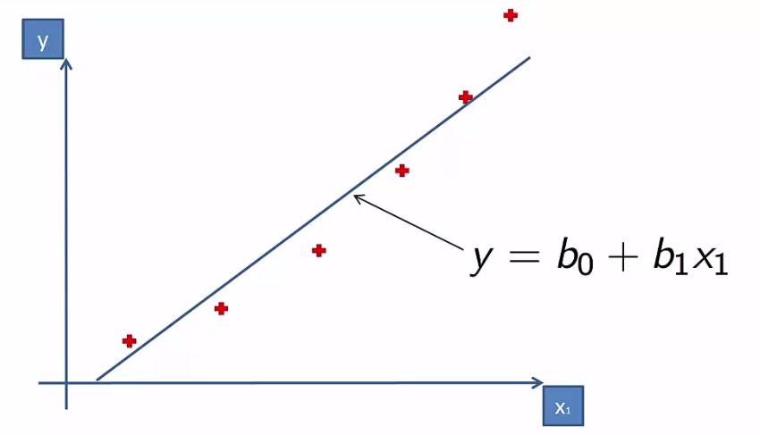
Simple Linear Regression

Slide 4
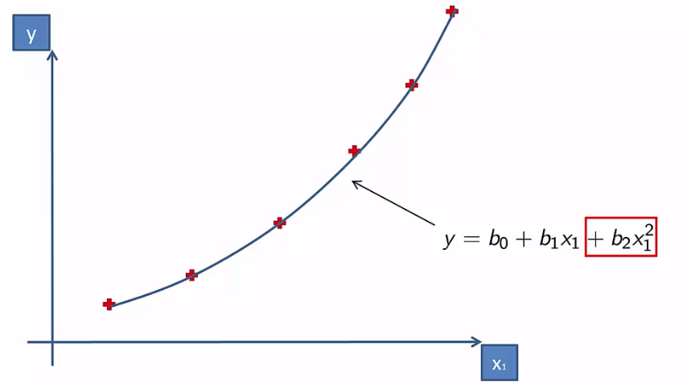
Polynomial Regression

Slide 5

Why “Linear”?
Its Non-Linear with respect to x-values.
But it is called linear due to the coefficient values.
Polynomial Linear Regression is the special version of Multiple Linear Regression.

Slide 6

Download the data set
2) Set the working directory
3) Read the data set

Slide 7
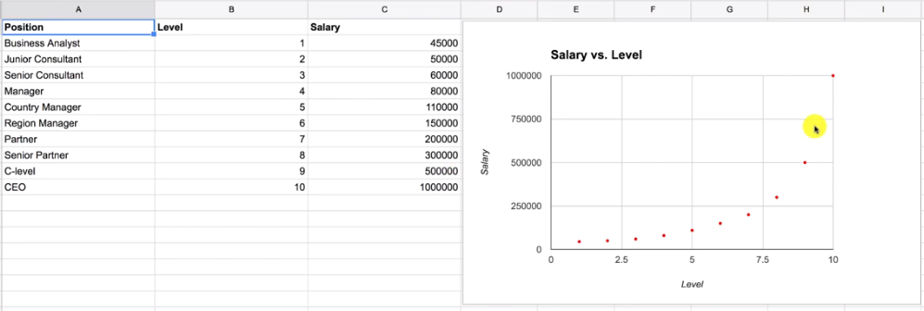

Slide 8


Slide 9


Summary(lin_reg)

Slide 10



Slide 11
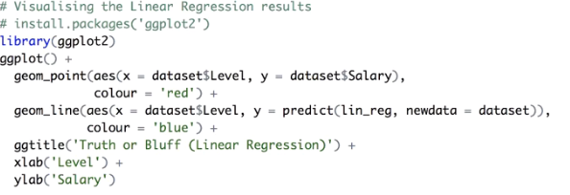

Slide 12
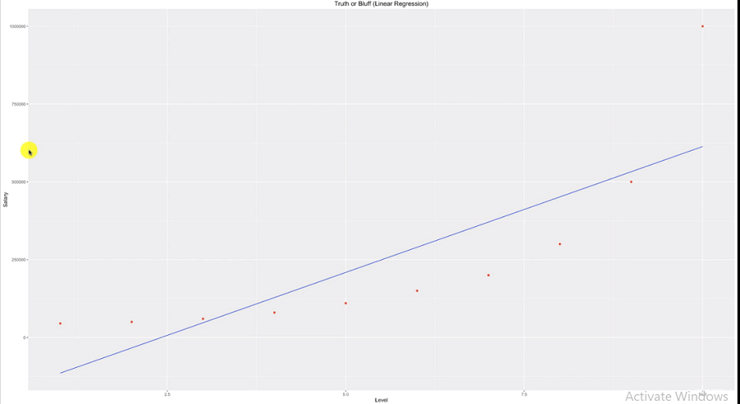

Slide 13


Slide 14
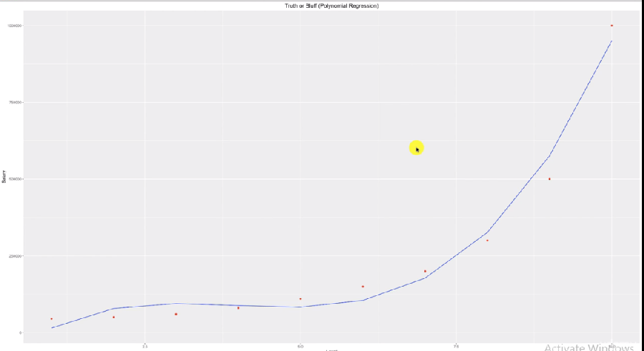

Slide 15
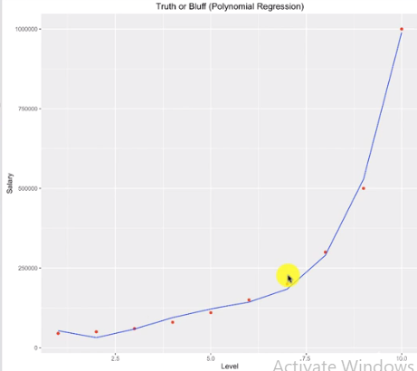
Adding One more Degree

Slide 16



Slide 17



